Slide 1
Single Sample Z-Test
Chad Williams
University of Victoria

Slide 2
Lecture Outline
Single Score versus Sample Mean
Single Sample Z-Test
Example

Slide 3
Lecture Outline
Single Score versus Sample Mean
Single Sample Z-Test
Example

Slide 4
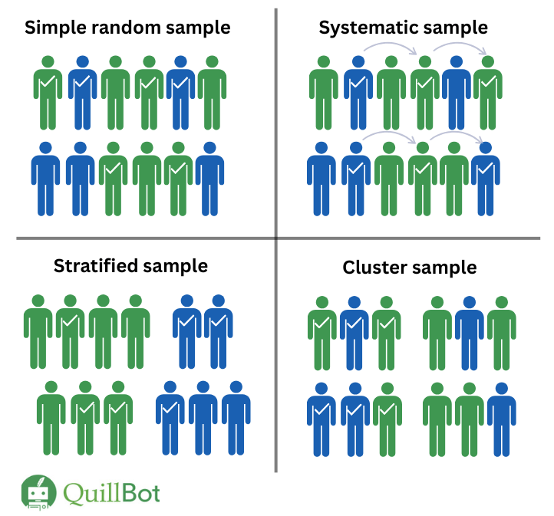
Single Participant versus Single Sample Design
Single-Participant Design: We are comparing a single participant’s score (x) to a distribution of population scores
Does my participant fit this population?
Single Sample Design: We are comparing a sample’s mean (x̅) to a distribution of possible population means
Does my sample fit this population?

Slide 5
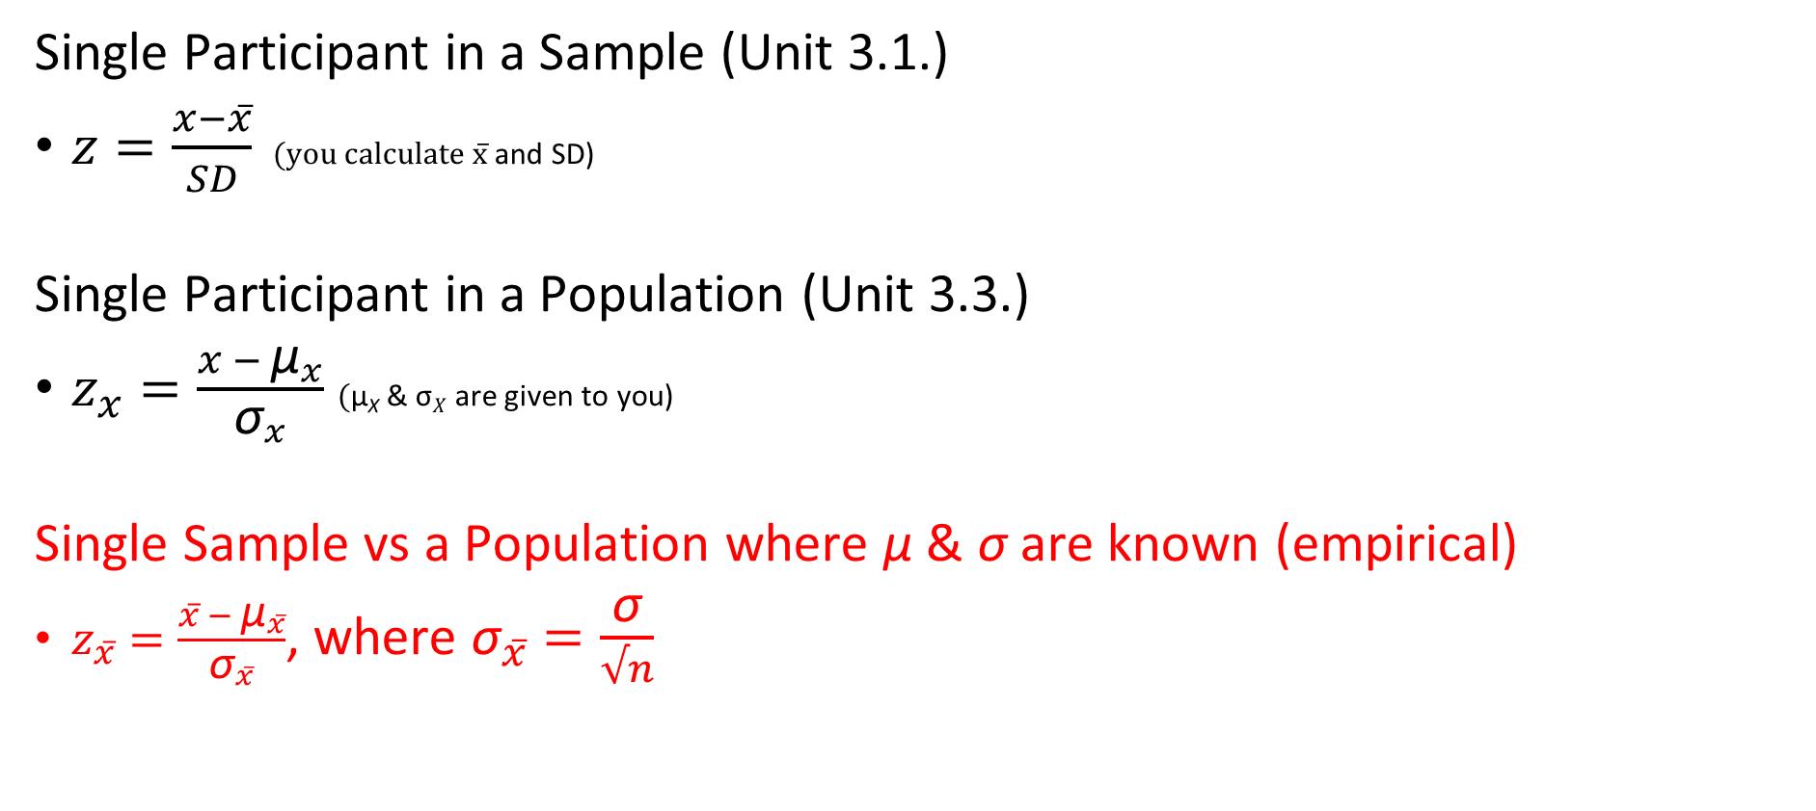
Single Participant vs Single Sample
Single Participant in a Sample (Unit 3.1.)
$z=\frac{x−x̅}{SD}$ $(\text{you} \text{calculate} \text{x}̅$and SD)
Single Participant in a Population (Unit 3.3.)
$z_{x}=\frac{x − {\text{μ}}_{x}}{{\text{σ}}_{x}}$ $(\text{μ}\text{X}$ & $\text{σ}X$ are given to you)
Single Sample vs a Population where $\text{μ} \text{\& }\text{σ}$ are known (empirical)
$z_{x̅}=\frac{x̅ − {\text{μ}}_{x̅}}{{\text{σ}}_{x̅}}$, where ${\text{σ}}_{x̅̅}=\frac{\text{σ}}{√n}$

Slide 6




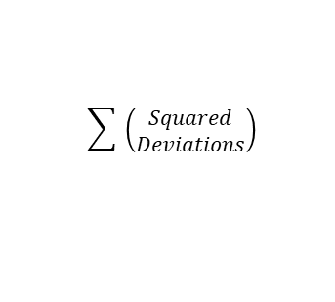

$$x − \bar{x}$$
$${deviations}^{2}$$
$$\sum{ \left(\begin{aligned}Squared \\ Deviations\end{aligned}\right)}$$
$$\frac{SS}{n}$$
$$\sqrt{{SD}^{2}}$$
$$\frac{x − \bar{x} }{SD}$$
Z-score
Table
X
Deviations
Squared
Deviations
Sum of Squares
(SS)
Variance
(SD²)
Standard
Deviation (SD)
Single Participant
Z-Score (Sample)
P-Value

Slide 7

$$x − \bar{x}$$
$${deviations}^{2}$$
$$\sum{ \left(\begin{aligned}Squared \\ Deviations\end{aligned}\right)}$$
$$\frac{SS}{n}$$
$$\sqrt{{SD}^{2}}$$
$$\frac{x − \bar{x} }{SD}$$
Z-score
Table
X
Deviations
Squared
Deviations
Sum of Squares
(SS)
Variance
(SD²)
Standard
Deviation (SD)
Single Participant
Z-Score (Sample)
P-Value
$$\frac{x − μ_{x}}{σ_{x}}$$
Z-score
Table
Single Participant
Z-Score (Population)
P-Value

Slide 8


$$\frac{\bar{x} − μ_{\bar{x}}}{σ_{\bar{x}}}$$
Z-score
Table
Standard Error
(σₓ̄)
Single Sample
Z-Score
P-Value
$$\frac{σ}{\sqrt{n}}$$
$$x − \bar{x}$$
$${deviations}^{2}$$
$$\sum{ \left(\begin{aligned}Squared \\ Deviations\end{aligned}\right)}$$
$$\frac{SS}{n}$$
$$\sqrt{{SD}^{2}}$$
$$\frac{x − \bar{x} }{SD}$$
Z-score
Table
X
Deviations
Squared
Deviations
Sum of Squares
(SS)
Variance
(SD²)
Standard
Deviation (SD)
Single Participant
Z-Score (Sample)
P-Value
$$\frac{x − μ_{x}}{σ_{x}}$$
Z-score
Table
P-Value
Single Participant
Z-Score (Population)

Slide 9
$$\frac{\bar{x} − μ_{\bar{x}}}{σ_{\bar{x}}}$$
Z-score
Table
Standard Error
(σₓ̄)
P-Value
Single Sample
Z-Score
$$\frac{σ}{\sqrt{n}}$$
$$x − \bar{x}$$
$${deviations}^{2}$$
$$\sum{ \left(\begin{aligned}Squared \\ Deviations\end{aligned}\right)}$$
$$\frac{SS}{n}$$
$$\sqrt{{SD}^{2}}$$
$$\frac{x − \bar{x} }{SD}$$
Z-score
Table
X
Deviations
Squared
Deviations
Sum of Squares
(SS)
Variance
(SD²)
Standard
Deviation (SD)
Single Participant
Z-Score (Sample)
P-Value
$$\frac{x − μ_{x}}{σ_{x}}$$
Z-score
Table
P-Value
Single Participant
Z-Score (Population)

Slide 10
Lecture Outline
Single Score versus Sample Mean
Single Sample Z-Test
Example

Slide 11

Step 1:
H₀: μ = 72.00
H₁: μ ≠ 72.00
Thus, two-tailed
Step 2:
Type of Research Design: Single Sample Design
Model of Hypothesis Testing: Random Sampling
Nature of Data (Scales of measurement): Score data
Statistic Being Analyzed: x̅
Information about the Population: μ = 72.00, σ = 51.00, N = 500
Sample Size: n = 25
Shape: Normally distributed
Step 3:
p(α) = .05, z(crit) = ±1.96
Step 4:
z(obs) = $\frac{72.0000 −90.0000}{\text{10.2}\text{00}\text{0}}$ = -1.7647
p(obs) = .0392 x 2 = .0784
Step 5:
p(obs) = .0784 > p(α) = .05
Fail to reject the null hypothesis
z(obs) = |-1.7647| < z(crit) = |1.96|
Fail to reject the null hypothesis
Step 6:
The stats problem generator group’s final exam scores (x̅ = 90.00%, SD = 1.37%, n = 25) were not statistically different than the average of the class (μ = 72.00, σ = 51.00), z = 1.76, p = .078.

Slide 12

Step 1:
H₀: μ = 72.00
H₁: μ ≠ 72.00
Thus, two-tailed
Step 2:
Type of Research Design: Single Sample Design
Model of Hypothesis Testing: Random Sampling
Nature of Data (Scales of measurement): Score data
Statistic Being Analyzed: x̅
Information about the Population: μ = 72.00, σ = 51.00, N = 500
Sample Size: n = 25
Shape: Normally distributed
Step 3:
p(α) = .05, z(crit) = ±1.96
Step 4:
z(obs) = $\frac{72.0000 −90.0000}{\text{10.2}\text{00}\text{0}}$ = -1.7647
p(obs) = .0392 x 2 = .0784
Step 5:
p(obs) = .0784 > p(α) = .05
Fail to reject the null hypothesis
z(obs) = |-1.7647| < z(crit) = |1.96|
Fail to reject the null hypothesis
Step 6:
The stats problem generator group’s final exam scores (x̅ = 90.00%, SD = 1.37%, n = 25) were not statistically different than the average of the class (μ = 72.00, σ = 51.00), z = 1.76, p = .078.

Slide 13
Step 2 - Changes
Type of Research Design | Single Participant Design | Single Sample Design (parameters known)
Model of Hypothesis Testing | Random Sampling | Random Sampling
Nature of Data | Score data | Score data
Statistic Being Analyzed | x | x̅
Information of Population | μ & σ known | μ & σ known
Sample Size | n = 1 | n = ___
Sampling Distribution | Sampling Distribution of a Score when population parameters are known | Sampling Distribution of the Mean when n = ___ and population parameters are known

Slide 14
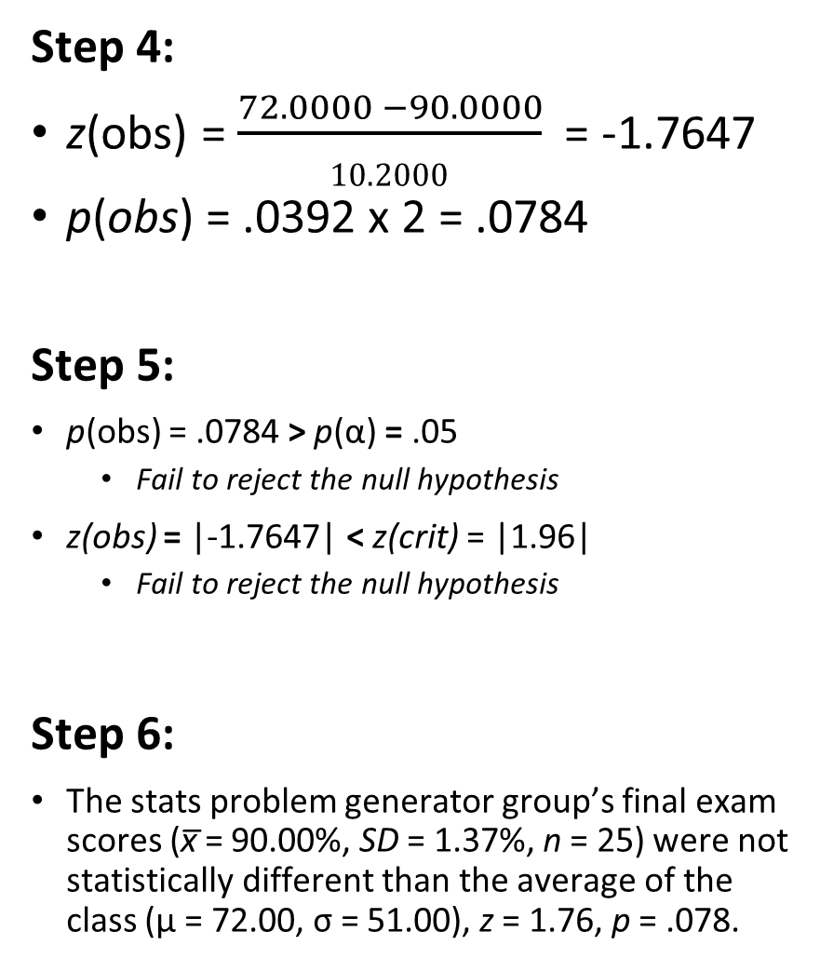
Step 1:
H₀: μ = 72.00
H₁: μ ≠ 72.00
Thus, two-tailed
Step 2:
Type of Research Design: Single Sample Design
Model of Hypothesis Testing: Random Sampling
Nature of Data (Scales of measurement): Score data
Statistic Being Analyzed: x̅
Information about the Population: μ = 72.00, σ = 51.00, N = 500
Sample Size: n = 25
Shape: Normally distributed
Step 3:
p(α) = .05, z(crit) = ±1.96
Step 4:
z(obs) = $\frac{72.0000 −90.0000}{\text{10.2}\text{00}\text{0}}$ = -1.7647
p(obs) = .0392 x 2 = .0784
Step 5:
p(obs) = .0784 > p(α) = .05
Fail to reject the null hypothesis
z(obs) = |-1.7647| < z(crit) = |1.96|
Fail to reject the null hypothesis
Step 6:
The stats problem generator group’s final exam scores (x̅ = 90.00%, SD = 1.37%, n = 25) were not statistically different than the average of the class (μ = 72.00, σ = 51.00), z = 1.76, p = .078.

Slide 15
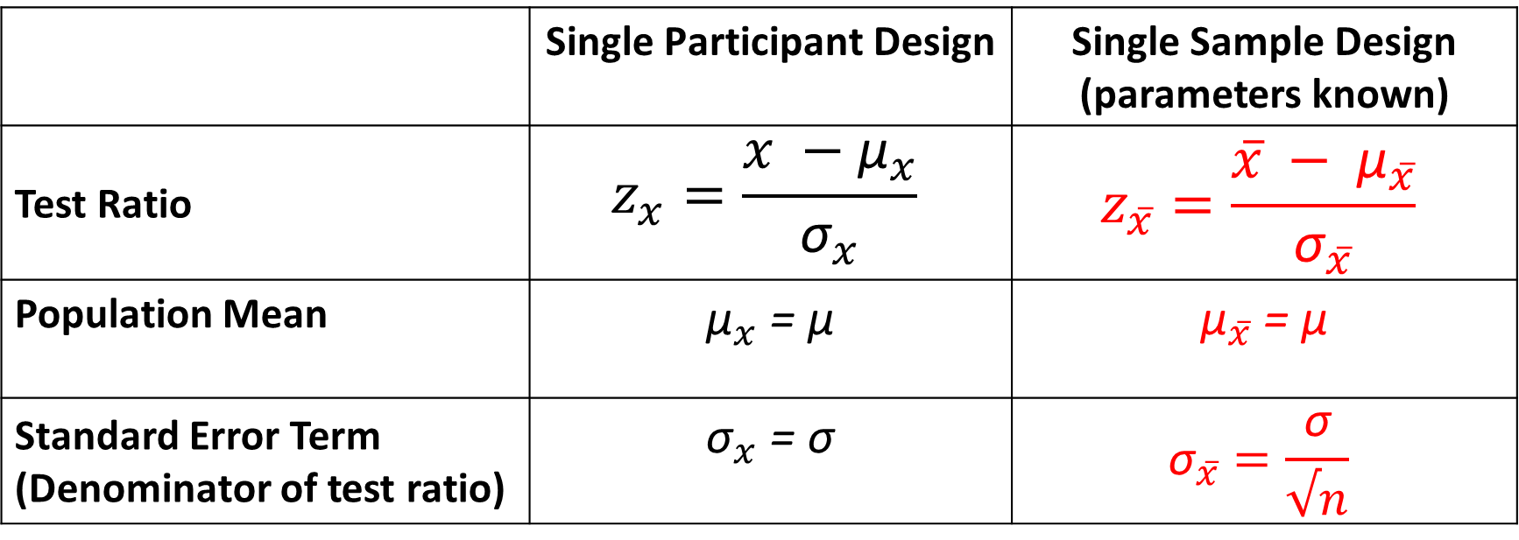
Step 4 - Changes
 | Single Participant Design | Single Sample Design (parameters known)
Test Ratio | $$z_{x}=\frac{x −{\text{μ}}_{x}}{{\text{σ}}_{x}}$$ | $$z_{x̅}=\frac{x̅ − {\text{μ}}_{x̅}}{{\text{σ}}_{x̅}}$$
Population Mean | ${\text{μ}}_{x}$ = $\text{μ}$ | ${\text{μ}}_{x̅}$ = $\text{μ}$
Standard Error Term (Denominator of test ratio) | ${\text{σ}}_{x}$ = $\text{σ}$ | $${\text{σ}}_{x̅̅}=\frac{\text{σ}}{√n}$$

Slide 16
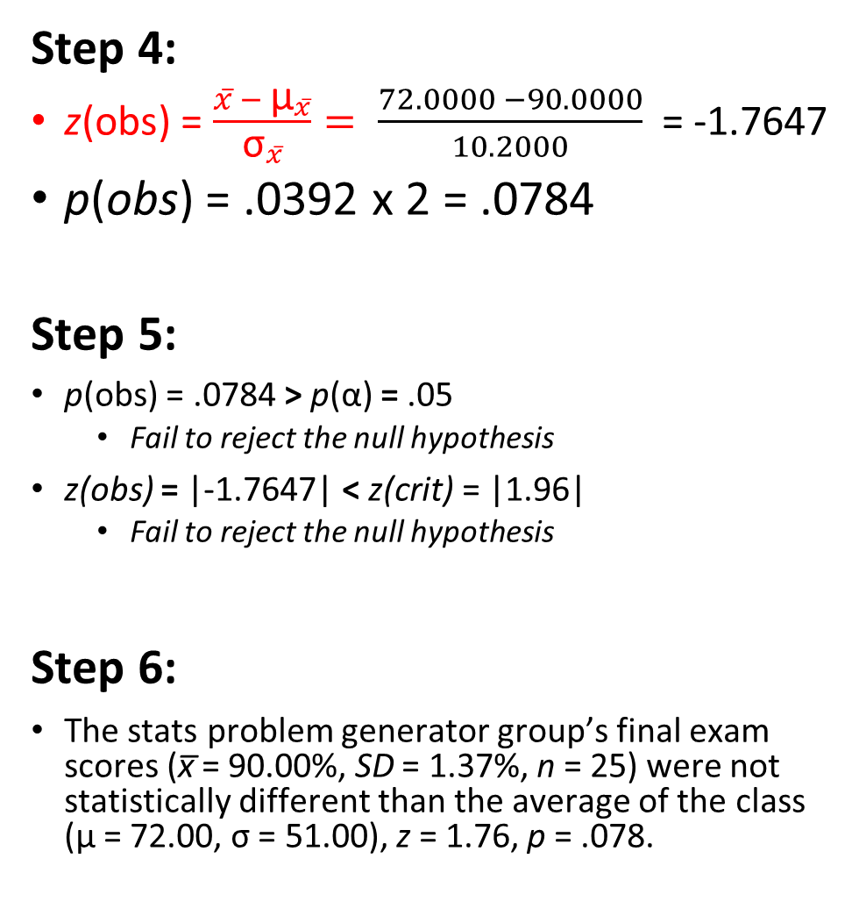
Step 1:
H₀: μ = 72.00
H₁: μ ≠ 72.00
Thus, two-tailed
Step 2:
Type of Research Design: Single Sample Design
Model of Hypothesis Testing: Random Sampling
Nature of Data (Scales of measurement): Score data
Statistic Being Analyzed: x̅
Information about the Population: μ = 72.00, σ = 51.00, N = 500
Sample Size: n = 25
Shape: Normally distributed
Step 3:
p(α) = .05, z(crit) = ±1.96
Step 4:
z(obs) = $\frac{x̅ − {\text{μ}}_{x̅}}{{\text{σ}}_{x̅}}= \frac{72.0000 −90.0000}{10.2000}$ = -1.7647
p(obs) = .0392 x 2 = .0784
Step 5:
p(obs) = .0784 > p(α) = .05
Fail to reject the null hypothesis
z(obs) = |-1.7647| < z(crit) = |1.96|
Fail to reject the null hypothesis
Step 6:
The stats problem generator group’s final exam scores (x̅ = 90.00%, SD = 1.37%, n = 25) were not statistically different than the average of the class (μ = 72.00, σ = 51.00), z = 1.76, p = .078.

Slide 17
Step 6 - Changes
 | Single Participant Design | Single Sample Design (parameters known)
Report | Jo’s final exam score of 90.00% was not statistically different than the average of the class (μ = 72.00, σ = 12.00), z = 1.50, p = .134. The problem generator did not affect Jo’s exam score. | The stats problem generator group’s final exam scores (x̅ = 90.00%, SD = 1.37%, n = 25) were not statistically different than the average of the class (μ = 72.00, σ = 51.00), z = 1.76, p = .078. The problem generator did not affect the group’s exam score.

Slide 18
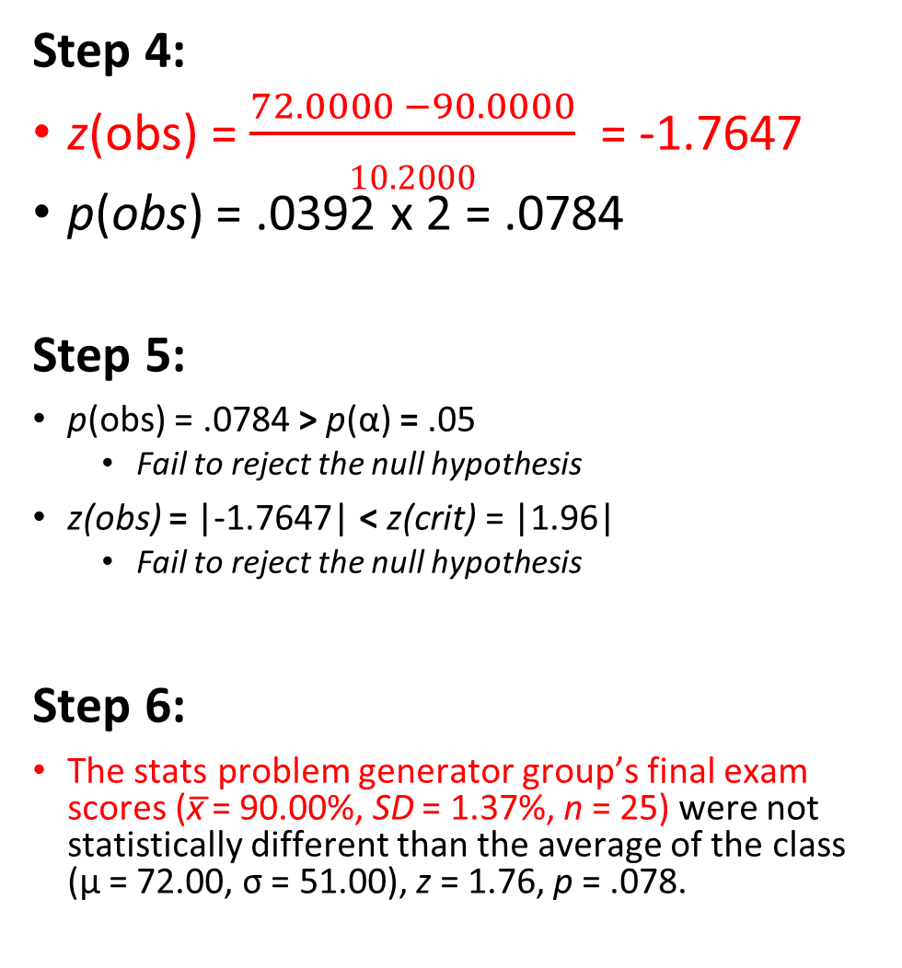
Step 1:
H₀: μ = 72.00
H₁: μ ≠ 72.00
Thus, two-tailed
Step 2:
Type of Research Design: Single Sample Design
Model of Hypothesis Testing: Random Sampling
Nature of Data (Scales of measurement): Score data
Statistic Being Analyzed: x̅
Information about the Population: μ = 72.00, σ = 51.00, N = 500
Sample Size: n = 25
Shape: Normally distributed
Step 3:
p(α) = .05, z(crit) = ±1.96
Step 4:
z(obs) = $\frac{72.0000 −90.0000}{\text{10.2}\text{00}\text{0}}$ = -1.7647
p(obs) = .0392 x 2 = .0784
Step 5:
p(obs) = .0784 > p(α) = .05
Fail to reject the null hypothesis
z(obs) = |-1.7647| < z(crit) = |1.96|
Fail to reject the null hypothesis
Step 6:
The stats problem generator group’s final exam scores (x̅ = 90.00%, SD = 1.37%, n = 25) were not statistically different than the average of the class (μ = 72.00, σ = 51.00), z = 1.76, p = .078.

Slide 19
Step 1:
H₀: μ = 72.00
H₁: μ ≠ 72.00
Thus, two-tailed
Step 2:
Type of Research Design: Single Sample Design
Model of Hypothesis Testing: Random Sampling
Nature of Data (Scales of measurement): Score data
Statistic Being Analyzed: x̅
Information about the Population: μ = 72.00, σ = 51.00, N = 500
Sample Size: n = 25
Shape: Normally distributed
Step 3:
p(α) = .05, z(crit) = ±1.96
Step 4:
z(obs) = $\frac{72.0000 −90.0000}{\text{10.2}\text{00}\text{0}}$ = -1.7647
p(obs) = .0392 x 2 = .0784
Step 5:
p(obs) = .0784 > p(α) = .05
Fail to reject the null hypothesis
z(obs) = |-1.7647| < z(crit) = |1.96|
Fail to reject the null hypothesis
Step 6:
The stats problem generator group’s final exam scores (x̅ = 90.00%, SD = 1.37%, n = 25) were not statistically different than the average of the class (μ = 72.00, σ = 51.00), z = 1.76, p = .078.

Slide 20
Lecture Outline
Single Score versus Sample Mean
Single Sample Z-Test
Example

Slide 21

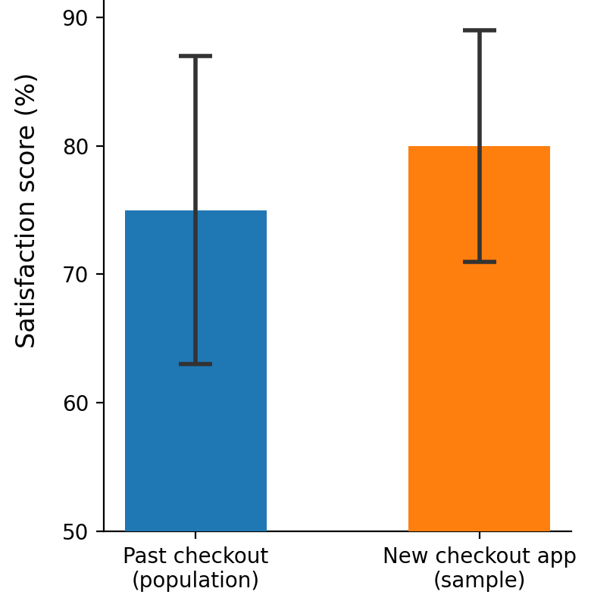
Single Sample Example
A retail company has decided to redesign its checkout app UI and roll it out to all of its customers. It is curious whether this affected customer satisfaction scores, in comparison to the store's past checkout experience (μ = 75.00%, σ = 12.00%). With twenty-five customers surveyed, satisfaction scores had a mean of x̅ = 80.00% and a standard deviation of SD = 9.00%. Did the introduction of the new checkout app UI affect customer satisfaction scores?

Slide 22
Step 1: Define Hypotheses
A retail company has decided to redesign its checkout app UI and roll it out to all of its customers. It is curious whether this affected customer satisfaction scores, in comparison to the store's past checkout experience (μ = 75.00%, σ = 12.00%). With twenty-five customers surveyed, satisfaction scores had a mean of x̅ = 80.00% and a standard deviation of SD = 9.00%. Did the introduction of the new checkout app UI affect customer satisfaction scores?
H₀: μ = 75.00
There will be no difference of satisfaction scores between the new UI and the old UI
H₁: μ ≠ 75.00
There will be a difference of satisfaction scores between the new UI and the old UI

Slide 23
Step 1:
H₀: μ = 75.00
H₁: μ ≠ 75.00
Thus, two-tailed

Slide 24
Step 2: Select Sampling Distribution
A retail company has decided to redesign its checkout app UI and roll it out to all of its customers. It is curious whether this affected customer satisfaction scores, in comparison to the store's past checkout experience (μ = 75.00%, σ = 12.00%). With twenty-five customers surveyed, satisfaction scores had a mean of x̅ = 80.00% and a standard deviation of SD = 9.00%. Did the introduction of the new checkout app UI affect customer satisfaction scores?
Type of Research Design | Single Sample Design
Model of Hypothesis Testing | Random Sampling
Nature of Data | Score
Statistic Being Analyzed | x̅
Information of Population | μ = 75.00 & σ = 12.00
Sample Size | n = 25
Shape | Normally Distributed
Sampling Distribution | Sampling Distribution of the Mean when n = 25 and population parameters are known

Slide 25
Step 1:
H₀: μ = 75.00
H₁: μ ≠ 75.00
Thus, two-tailed
Step 2:
Type of Research Design: Single Sample Design
Model of Hypothesis Testing: Random Sampling
Nature of Data (Scales of measurement): Score data
Statistic Being Analyzed: x̅
Information about the Population: μ = 75.00, σ = 12.00
Sample Size: n = 25
Shape: Normally distributed

Slide 26
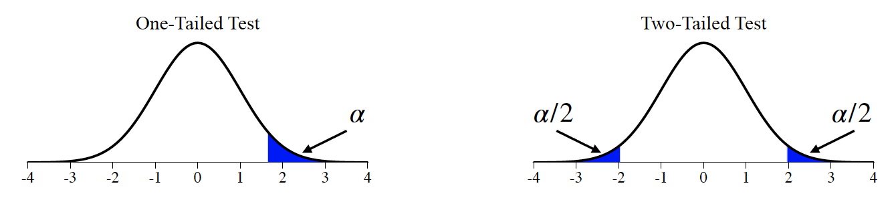
Step 3: Set a priori Criteria
A retail company has decided to redesign its checkout app UI and roll it out to all of its customers. It is curious whether this affected customer satisfaction scores, in comparison to the store's past checkout experience (μ = 75.00%, σ = 12.00%). With twenty-five customers surveyed, satisfaction scores had a mean of x̅ = 80.00% and a standard deviation of SD = 9.00%. Did the introduction of the new checkout app UI affect customer satisfaction scores?
p(α): = .05 (two-tailed)
z(crit): ±1.96

Slide 27
Step 1:
H₀: μ = 75.00
H₁: μ ≠ 75.00
Thus, two-tailed
Step 2:
Type of Research Design: Single Sample Design
Model of Hypothesis Testing: Random Sampling
Nature of Data (Scales of measurement): Score data
Statistic Being Analyzed: x̅
Information about the Population: μ = 75.00, σ = 12.00
Sample Size: n = 25
Shape: Normally distributed
Step 3:
p(α) = .05, z(crit) = ±1.96

Slide 28

Step 4: Compute Statistics
A retail company has decided to redesign its checkout app UI and roll it out to all of its customers. It is curious whether this affected customer satisfaction scores, in comparison to the store's past checkout experience (μ = 75.00%, σ = 12.00%). With twenty-five customers surveyed, satisfaction scores had a mean of x̅ = 80.00% and a standard deviation of SD = 9.00%. Did the introduction of the new checkout app UI affect customer satisfaction scores?
$z(obs)=\frac{x̅ − {\text{μ}}_{x̅}}{{\text{σ}}_{x̅}}$, where ${\text{σ}}_{x̅̅}=\frac{\text{σ}}{√n}$

Slide 29
$$\frac{\bar{x} − μ_{\bar{x}}}{σ_{\bar{x}}}$$
Z-score
Table
Standard Error
(σₓ̄)
Single Sample
Z-Score
P-Value
$$\frac{σ}{\sqrt{n}}$$
$$x − \bar{x}$$
$${deviations}^{2}$$
$$\sum{ \left(\begin{aligned}Squared \\ Deviations\end{aligned}\right)}$$
$$\frac{SS}{n}$$
$$\sqrt{{SD}^{2}}$$
$$\frac{x − \bar{x} }{SD}$$
Z-score
Table
X
Deviations
Squared
Deviations
Sum of Squares
(SS)
Variance
(SD²)
Standard
Deviation (SD)
Single Participant
Z-Score (Sample)
P-Value
$$\frac{x − μ_{x}}{σ_{x}}$$
Z-score
Table
P-Value
Single Participant
Z-Score (Population)

Slide 30
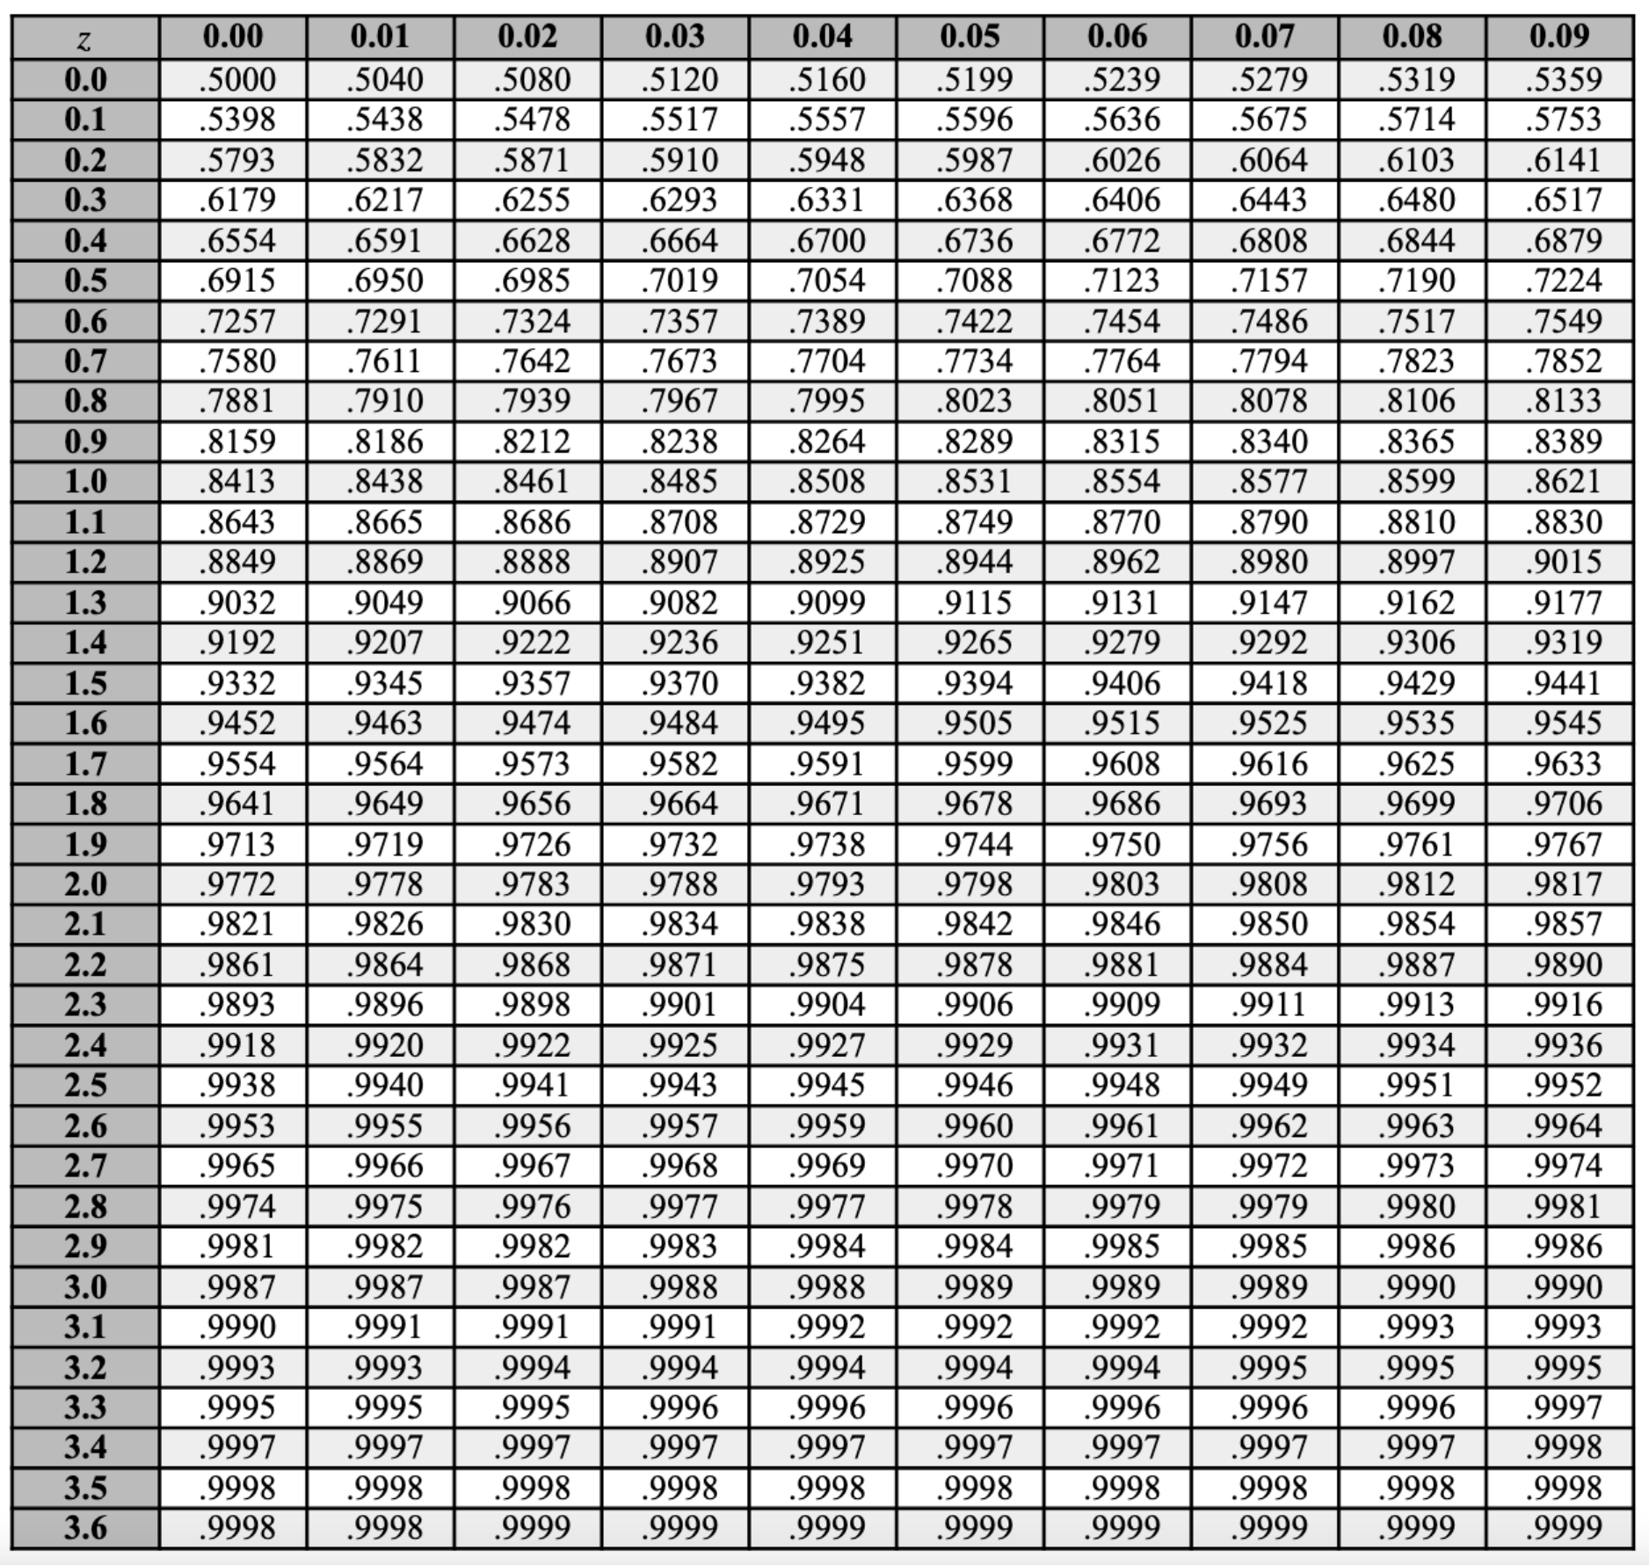
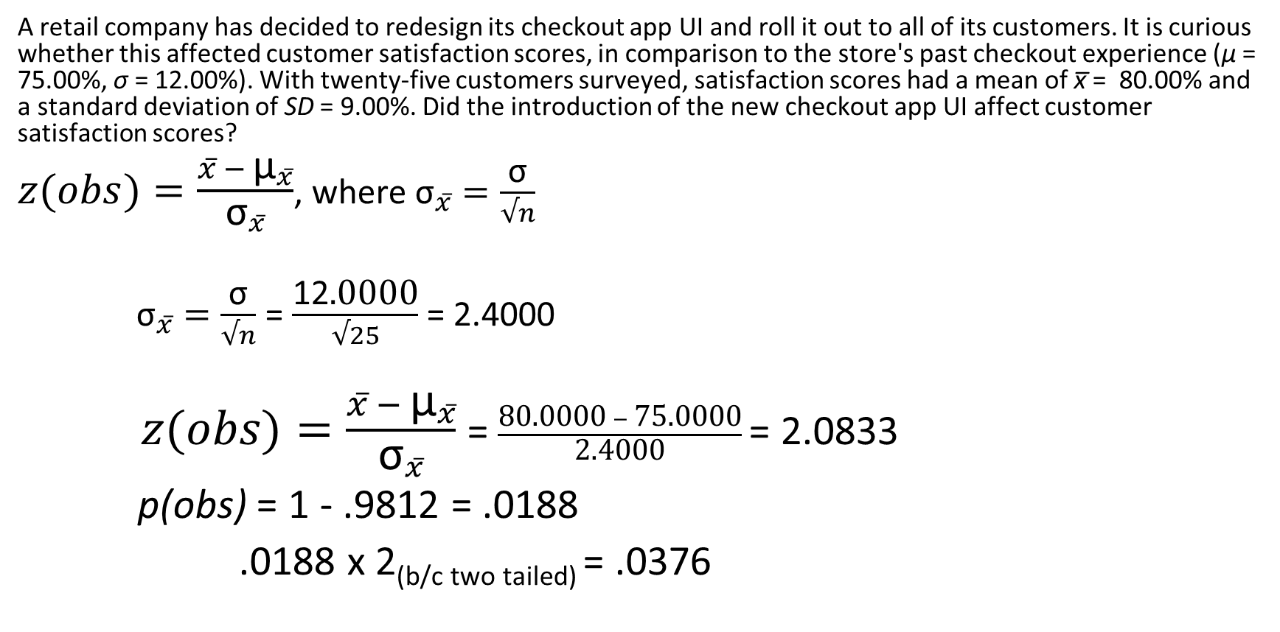
Step 4: Compute Statistics
A retail company has decided to redesign its checkout app UI and roll it out to all of its customers. It is curious whether this affected customer satisfaction scores, in comparison to the store's past checkout experience (μ = 75.00%, σ = 12.00%). With twenty-five customers surveyed, satisfaction scores had a mean of x̅ = 80.00% and a standard deviation of SD = 9.00%. Did the introduction of the new checkout app UI affect customer satisfaction scores?
$z(obs)=\frac{x̅ − {\text{μ}}_{x̅}}{{\text{σ}}_{x̅}}$, where ${\text{σ}}_{x̅̅}=\frac{\text{σ}}{√n}$
${\text{σ}}_{x̅̅}=\frac{\text{σ}}{√n}$ = $\frac{\text{12}\text{.0}\text{00}\text{0}}{√25}$ = 2.4000
$z(obs)=\frac{x̅ − {\text{μ}}_{x̅}}{{\text{σ}}_{x̅}}$= $\frac{\text{80}\text{.0}\text{00}\text{0} − \text{75}\text{.0}\text{00}\text{0}}{\text{2}\text{.4000}}$ = 2.0833
p(obs) = 1 - .9812 = .0188
.0188 x 2_{(b/c two tailed)} = .0376

Slide 31

Step 1:
H₀: μ = 75.00
H₁: μ ≠ 75.00
Thus, two-tailed
Step 2:
Type of Research Design: Single Sample Design
Model of Hypothesis Testing: Random Sampling
Nature of Data (Scales of measurement): Score data
Statistic Being Analyzed: x̅
Information about the Population: μ = 75.00, σ = 12.00
Sample Size: n = 25
Shape: Normally distributed
Step 3:
p(α) = .05, z(crit) = ±1.96
Step 4:
z(obs) = $\frac{80.0000 −75.0000}{\text{2.40}\text{00}}$ = 2.0833
p(obs) = .0188 x 2 = .0376

Slide 32
Step 5: Make Statistical Decision
A retail company has decided to redesign its checkout app UI and roll it out to all of its customers. It is curious whether this affected customer satisfaction scores, in comparison to the store's past checkout experience (μ = 75.00%, σ = 12.00%). With twenty-five customers surveyed, satisfaction scores had a mean of x̅ = 80.00% and a standard deviation of SD = 9.00%. Did the introduction of the new checkout app UI affect customer satisfaction scores?
z(obs) = 2.0833 z(crit) = ±1.96
p(obs) = .0376 p(α) = .05

Slide 33
Step 5: Make Statistical Decision
A retail company has decided to redesign its checkout app UI and roll it out to all of its customers. It is curious whether this affected customer satisfaction scores, in comparison to the store's past checkout experience (μ = 75.00%, σ = 12.00%). With twenty-five customers surveyed, satisfaction scores had a mean of x̅ = 80.00% and a standard deviation of SD = 9.00%. Did the introduction of the new checkout app UI affect customer satisfaction scores?
z(obs) = 2.0833 > z(crit) = ±1.96
p(obs) = .0376 < p(α) = .05
Reject the null hypothesis, accept the alternative hypothesis

Slide 34
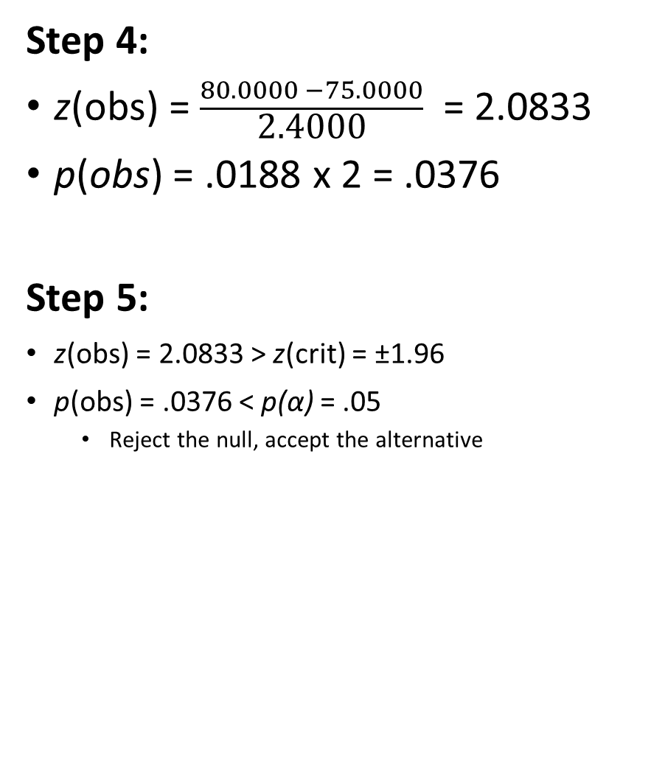
Step 1:
H₀: μ = 75.00
H₁: μ ≠ 75.00
Thus, two-tailed
Step 2:
Type of Research Design: Single Sample Design
Model of Hypothesis Testing: Random Sampling
Nature of Data (Scales of measurement): Score data
Statistic Being Analyzed: x̅
Information about the Population: μ = 75.00, σ = 12.00
Sample Size: n = 25
Shape: Normally distributed
Step 3:
p(α) = .05, z(crit) = ±1.96
Step 4:
z(obs) = $\frac{80.0000 −75.0000}{\text{2.40}\text{00}}$ = 2.0833
p(obs) = .0188 x 2 = .0376
Step 5:
z(obs) = 2.0833 > z(crit) = ±1.96
p(obs) = .0376 < p(α) = .05
Reject the null, accept the alternative

Slide 35
Step 6: Interpret your Outcome
A retail company has decided to redesign its checkout app UI and roll it out to all of its customers. It is curious whether this affected customer satisfaction scores, in comparison to the store's past checkout experience (μ = 75.00%, σ = 12.00%). With twenty-five customers surveyed, satisfaction scores had a mean of x̅ = 80.00% and a standard deviation of SD = 9.00%. Did the introduction of the new checkout app UI affect customer satisfaction scores?
The new checkout app UI satisfaction scores (x̅ = 80.00%, SD = 9.00%, n = 25) were statistically higher than satisfaction scores for the old UI (μ = 75.00%, σ = 12.00%), z = 2.08, p = .038. The redesigned UI increased satisfaction scores.

Slide 36
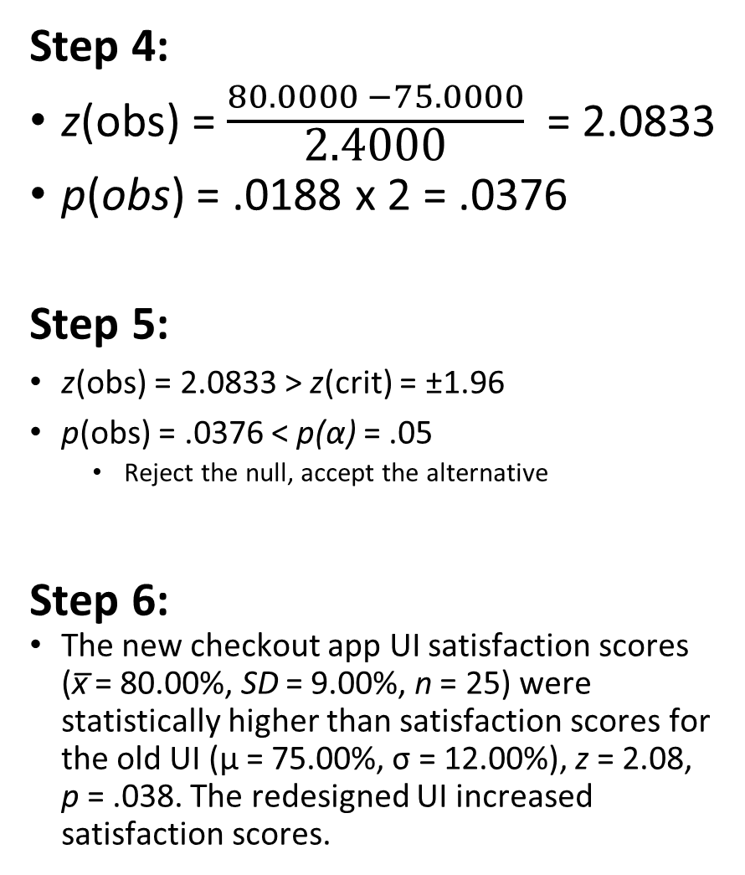
Step 1:
H₀: μ = 75.00
H₁: μ ≠ 75.00
Thus, two-tailed
Step 2:
Type of Research Design: Single Sample Design
Model of Hypothesis Testing: Random Sampling
Nature of Data (Scales of measurement): Score data
Statistic Being Analyzed: x̅
Information about the Population: μ = 75.00, σ = 12.00
Sample Size: n = 25
Shape: Normally distributed
Step 3:
p(α) = .05, z(crit) = ±1.96
Step 4:
z(obs) = $\frac{80.0000 −75.0000}{\text{2.40}\text{00}}$ = 2.0833
p(obs) = .0188 x 2 = .0376
Step 5:
z(obs) = 2.0833 > z(crit) = ±1.96
p(obs) = .0376 < p(α) = .05
Reject the null, accept the alternative
Step 6:
The new checkout app UI satisfaction scores (x̅ = 80.00%, SD = 9.00%, n = 25) were statistically higher than satisfaction scores for the old UI (μ = 75.00%, σ = 12.00%), z = 2.08, p = .038. The redesigned UI increased satisfaction scores.

Slide 37
Extra Resources

Slide 38
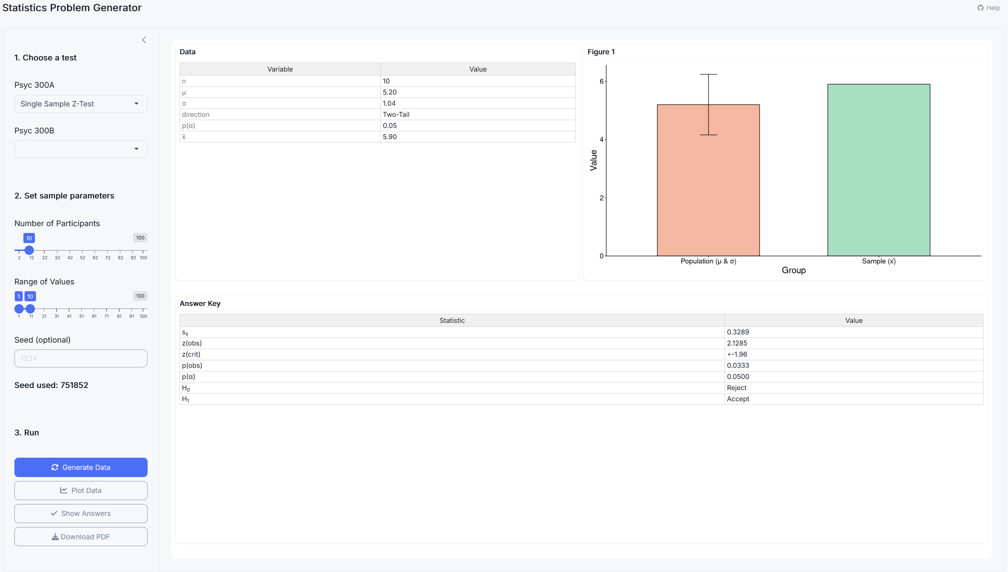
Stats Problem Generator
https://chadcwilliams.shinyapps.io/StatsProblemGenerator/

Slide 39
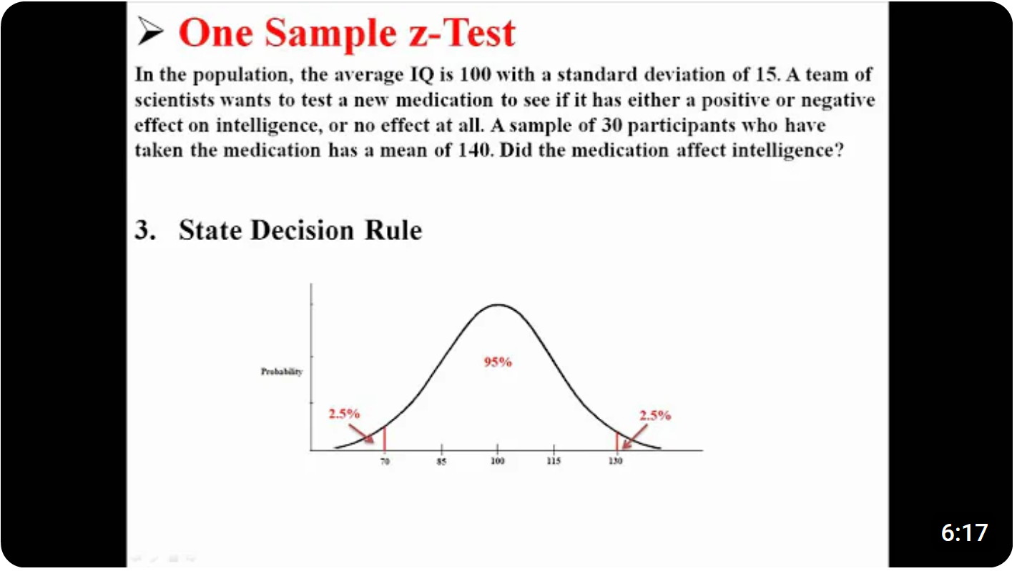
Extra Resources

